Slide 1
Class 6
BUS 696
Prof. Jonathan Hersh

Slide 2
BUS 696: Class 6 Announcements
Pset 4 solutions
Problem Set 5 Posted
Final Project
Project details posted
Questions?

Slide 3
BUS 696: Class 6 Outline
AI in the News
Review
Lift Charts
Calibration Plots
Severe Class Imbalance Issues
Leave-One-Out Cross-Validation
K-Fold Cross-Validation
Bootstrapping

Slide 4
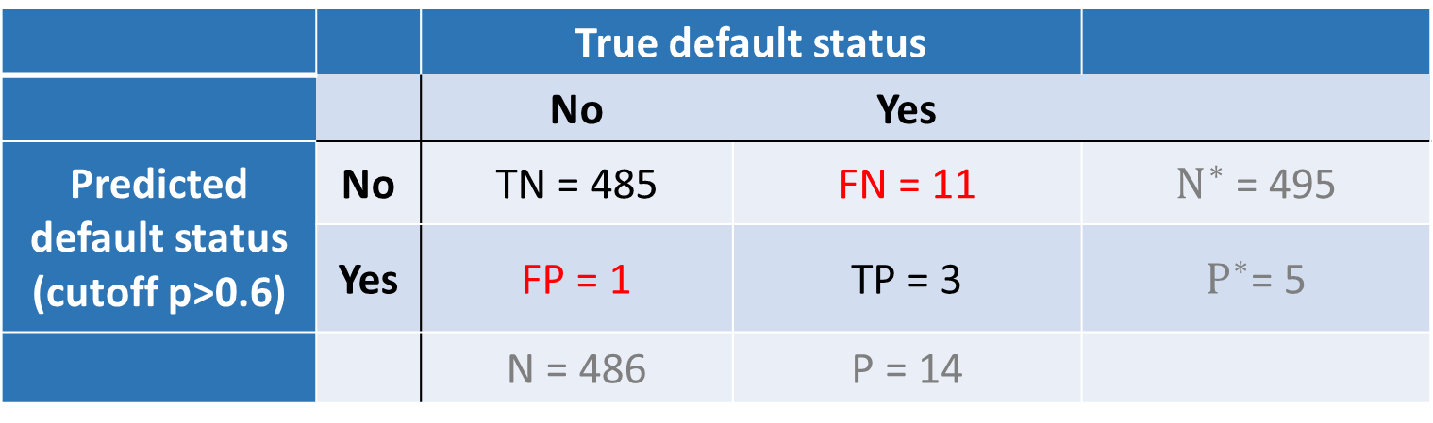
Review: Sensitivity and Specificity
 |  | True default status
 |  | No | Yes
Predicted default status (cutoff p>0.6) | No | TN = 485 | FN = 11 | $N^{∗}$ = 495
 | Yes | FP = 1 | TP = 3 | $P^{∗}$= 5
 |  | N = 486 | P = 14
Sensitivity: True positive rate (aka 1 – power or recall)
TP/P = 3 / 14 = 21.4%
Specificity: True negative rate
TN/N = 485 / 486= 99.7%
False positive rate (aka Type I error, 1 - Specificity)
FP/N = 1/486= 0.002%

Slide 5
ROC Curve
Cutoff p>0.01
100%
If model is no better than chance on this line
Can we show consequences of FPs and FNs as we vary the cutoff probability to assign classes?
Idea of a ROC (Receiver Operator Curve) plot
True positive
rate
Cutoff p>0.4
Cutoff p>0.5
Cutoff | TPR | FPR
0.01 | 100% | 22.6%
0.4 | 57% | 0.008
0.5 | 21.4% | 0.004%
0.6 | 21.4% | 0.002%
False Positive Rate
100%

Slide 6
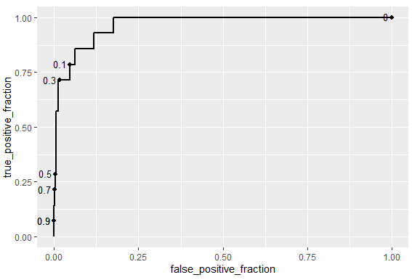
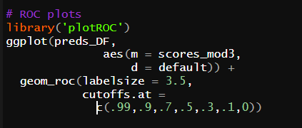
ROC Curves in R

Slide 7
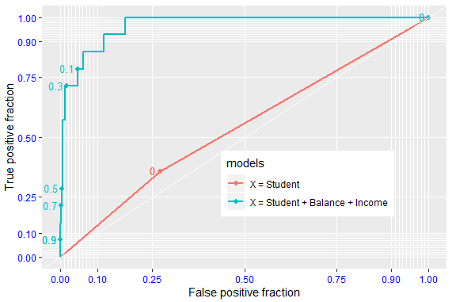

AUC = Area Under Curve
Better models lie up and to the left
AUC calculates how much total area is under a particular curve
E.g. model with just X = student is much worse than X = student + balance + income

Slide 8
BUS 696: Class 6 Outline
AI in the News
Review
Lift Charts
Calibration Plots
Severe Class Imbalance Issues
Leave-One-Out Cross-Validation
K-Fold Cross-Validation
Bootstrapping

Slide 9
Lift Chart
45 degree line:
Model is no better than chance
How useful is our predictive model?
One way of judging this is to say if we order observations by model predictions (highest to lowest) how many observations will we have to “test” before we find all observations with the event
Better than chance
% samples
found
Worse than chance
% samples tested

Slide 10
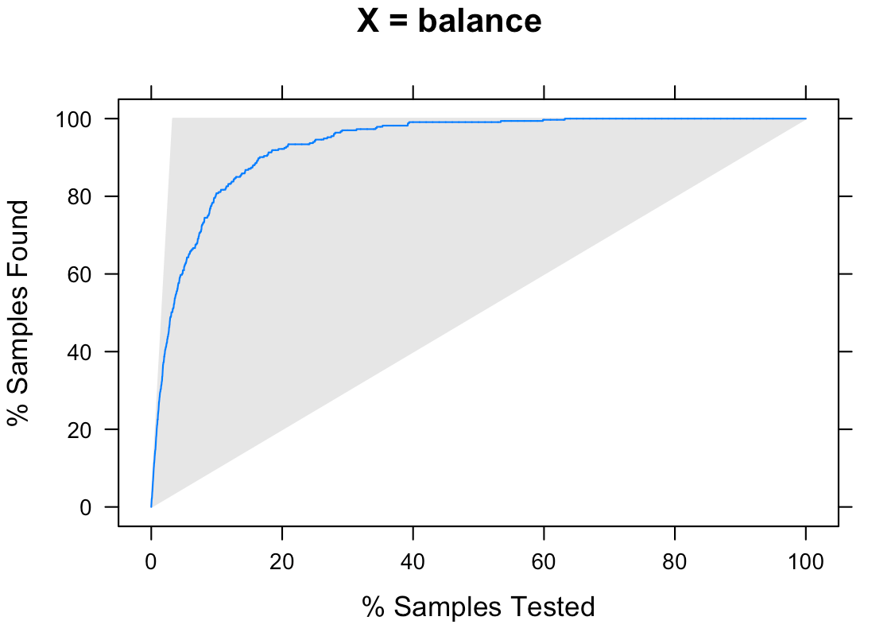
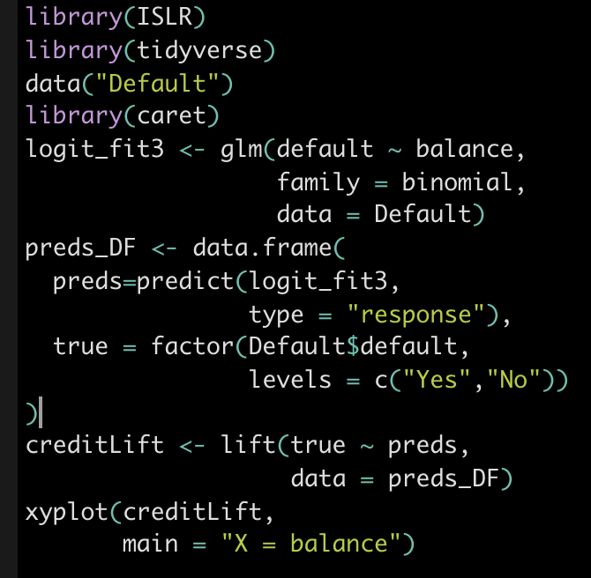
Line measures % of obs with event in our sample

Slide 11
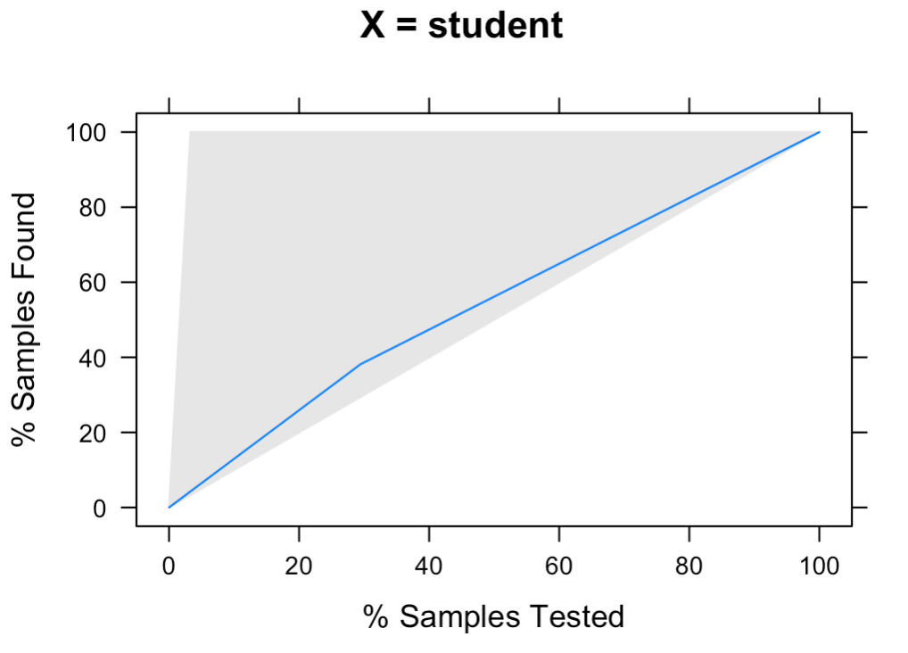
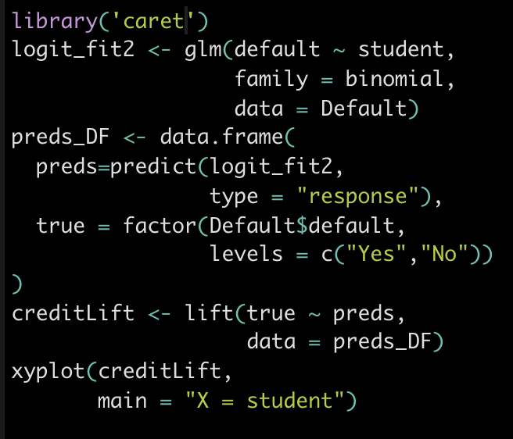
Lift Chart

Slide 12
BUS 696: Class 6 Outline
AI in the News
Review
Lift Charts
Calibration Plots
Severe Class Imbalance Issues
Leave-One-Out Cross-Validation
K-Fold Cross-Validation
Bootstrapping

Slide 13
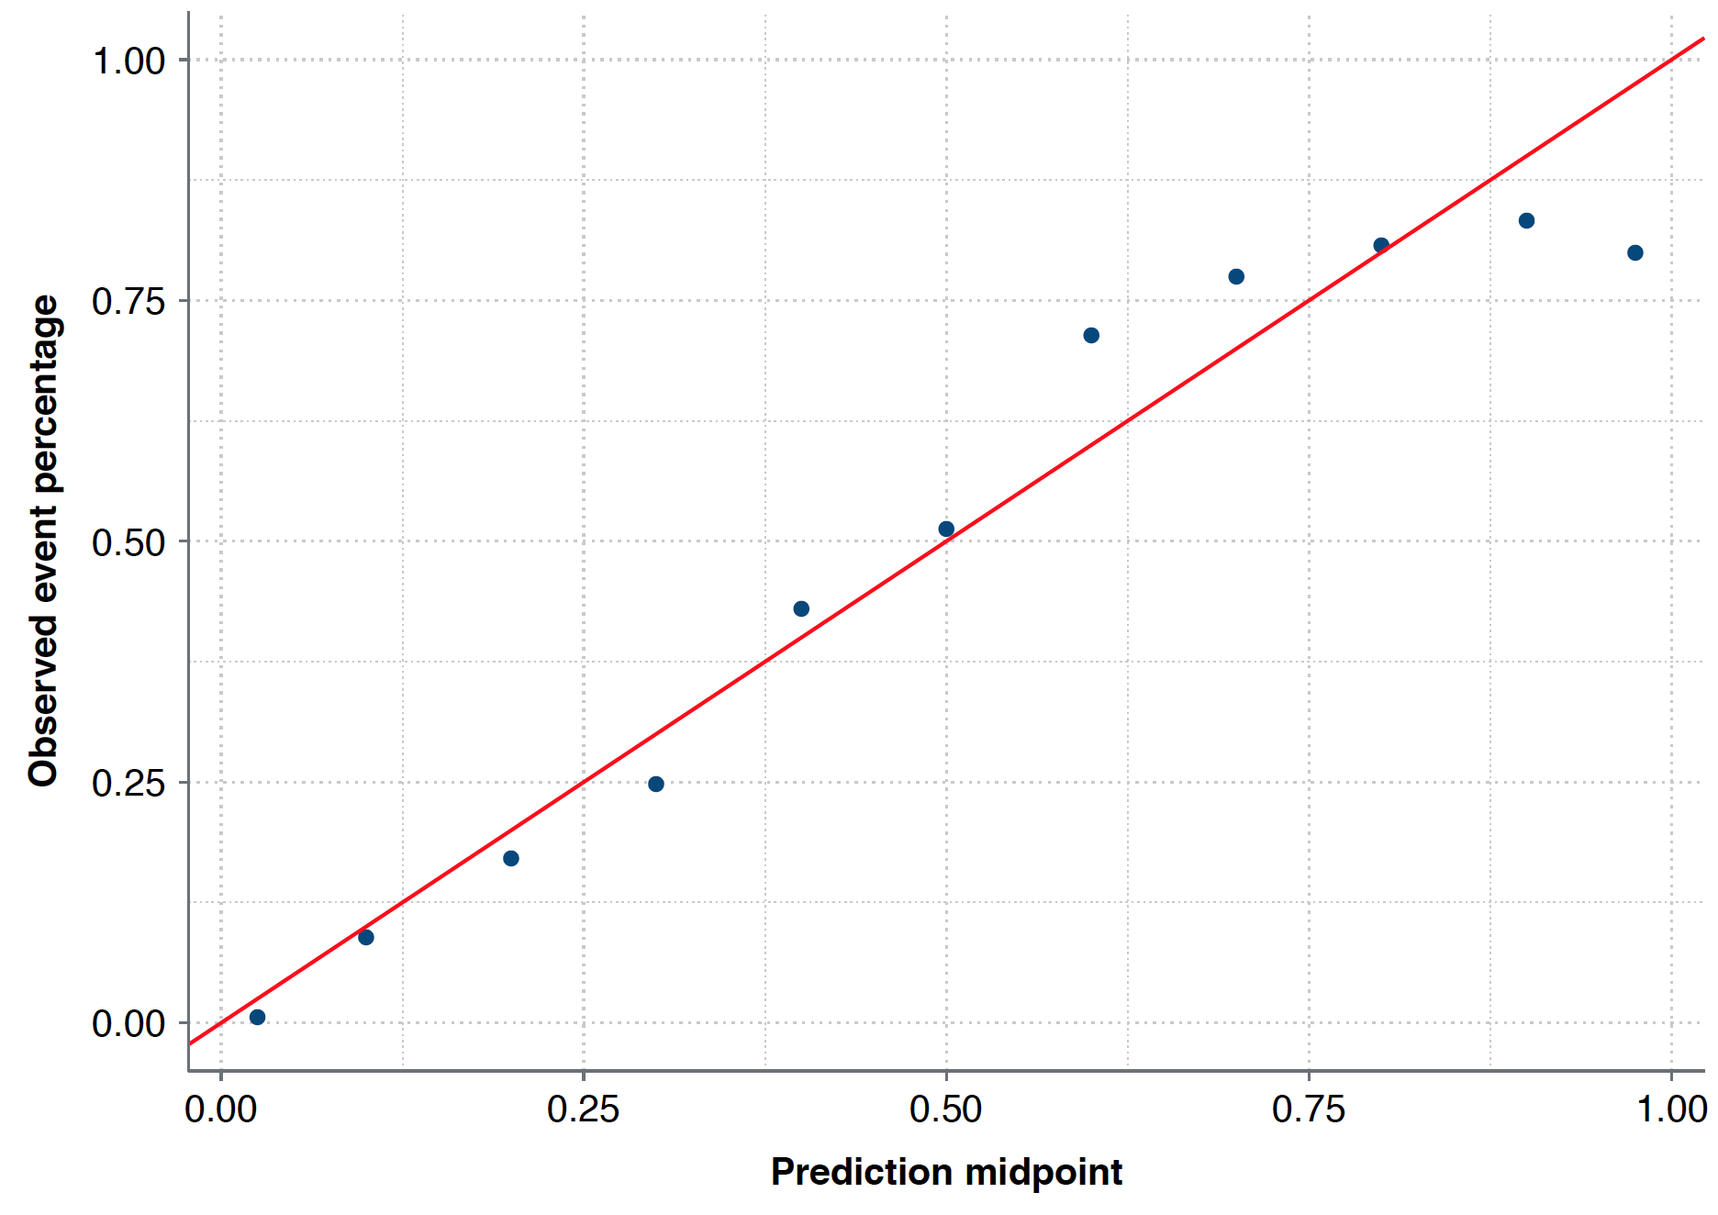
Calibration plot
Idea of a calibration plot:
A well-calibrated prediction is one where if we give an X% probability of an event occurring, X/100 of the time the event happens.
For 1/10 of them the event should actually occur
All obs where we predict
10% chance of event occuring

Slide 14
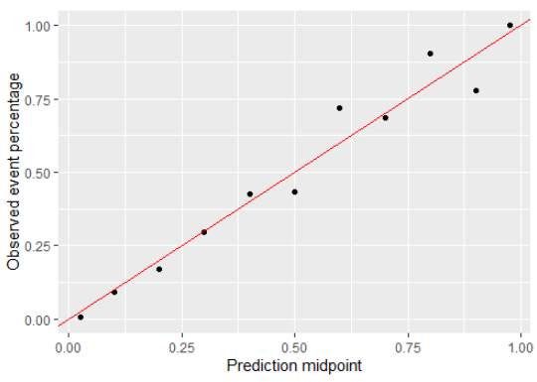
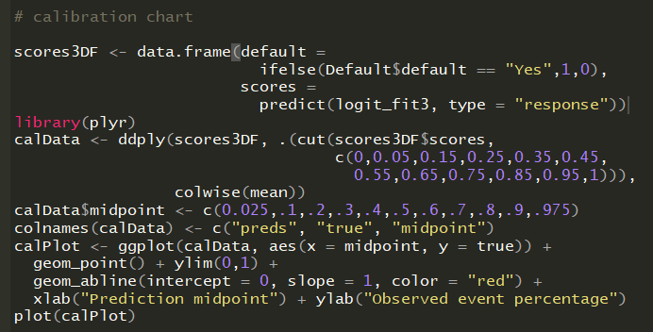
Calibration plot

Slide 15
BUS 696: Class 6 Outline
AI in the News
Review
Lift Charts
Calibration Plots
Severe Class Imbalance Issues
Leave-One-Out Cross-Validation
K-Fold Cross-Validation
Bootstrapping

Slide 16
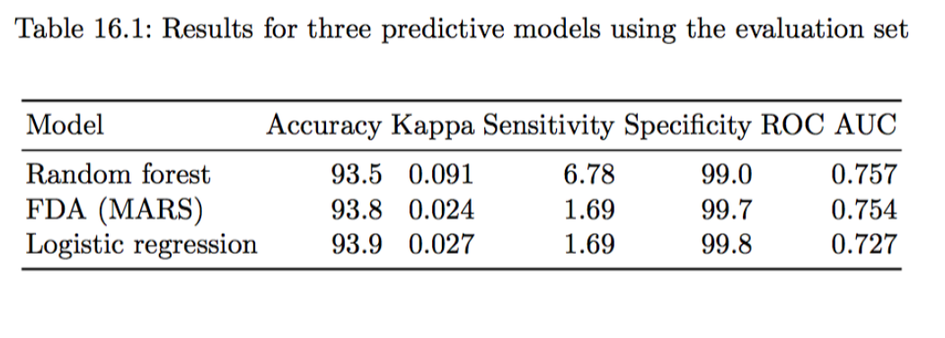
Severe class imbalance
Severe class imbalance occurs when one class highly outnumbers another
e.g. 98% non-defaults and 2% defaults
Even fancy models can’t solve this
Low sensitivity => low TP/P = True Positive Rate

Slide 17
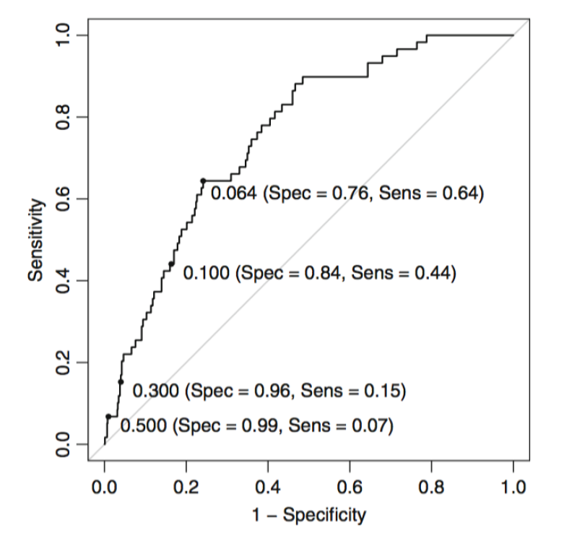
Remedy 1: alternate score cutoff

Slide 18
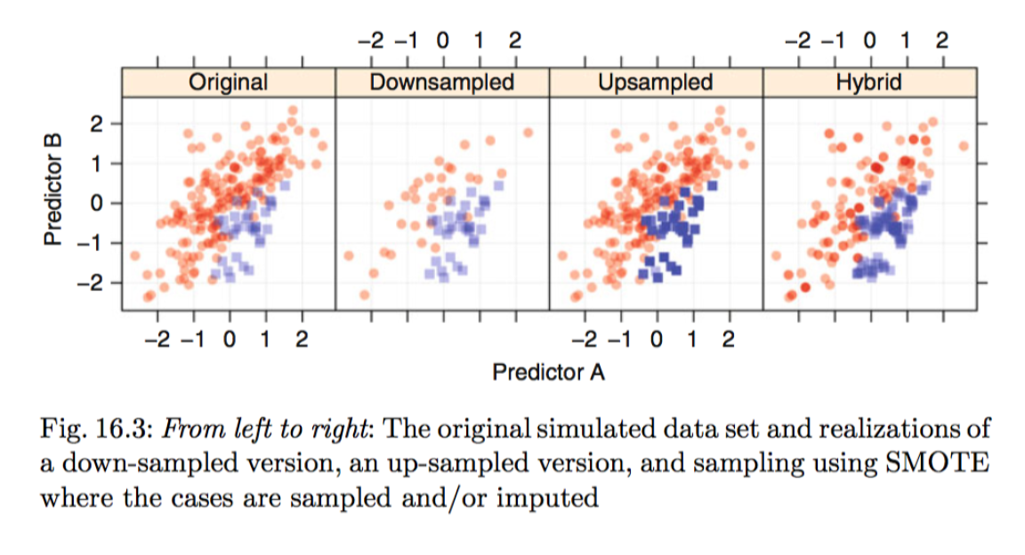
Remedies 2,3&4 under-sample majority class, oversample minority class, SMOTE interpolate minority class

Slide 19
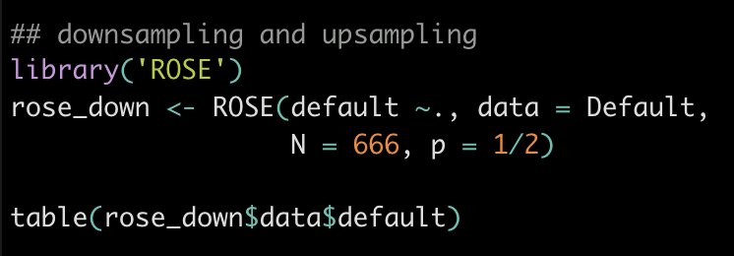
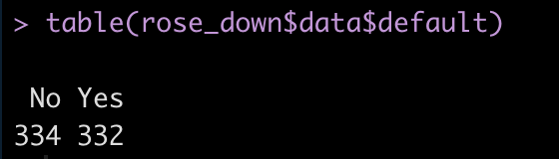
Downsampling using ROSE
N = size of dataset desired
p = probability of event in desired dataset
Set N = p*nrow(origina datset) to down sample

Slide 20
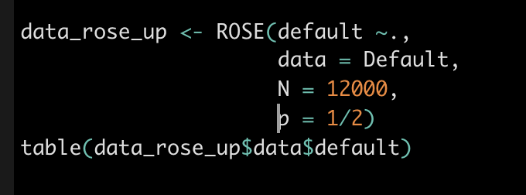
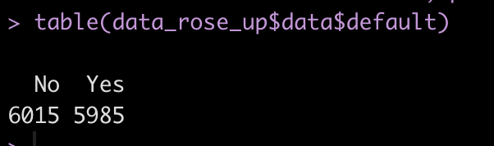
Upsampling using ROSE
N = size of dataset desired
p = probability of event in desired dataset
Set N > nrow(origina datset) to up sample

Slide 21
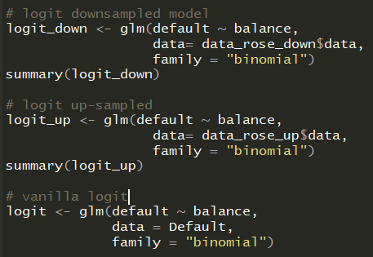
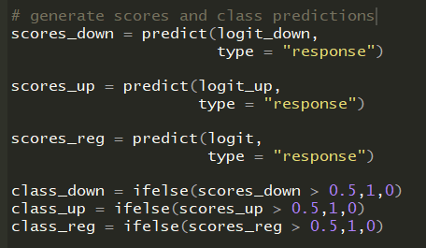
Fit Models on Upsampled/Downsampled Data

Slide 22
Model Diagnostics on Up-Sampled/Down-Sampled Models
 | Vanilla Logit | Down-Sampled Logit | Up-Sampled Logit
Accuracy | 0.872 | 0.869 | 0.972
True Positives | 307 | 5282 | 100
True Negs | 274 | 5149 | 9625
Sensitivity | 0.9 | 0.88 | 0.3
Specificity | 0.843 | 0.859 | 0.996
False Pos Rate | 0.157 | 0.141 | 0.004

Slide 23
Remedy 5: Adjust Likelihood Cost Parameter
Another alternative: adjust “cost” of FN in Likelihood estimation
We won’t cover this, but it’s useful in practice.

Slide 24
BUS 696: Class 6 Outline
AI in the News
Review
Lift Charts
Calibration Plots
Severe Class Imbalance Issues
Leave-One-Out Cross-Validation
K-Fold Cross-Validation
Bootstrapping

Slide 25

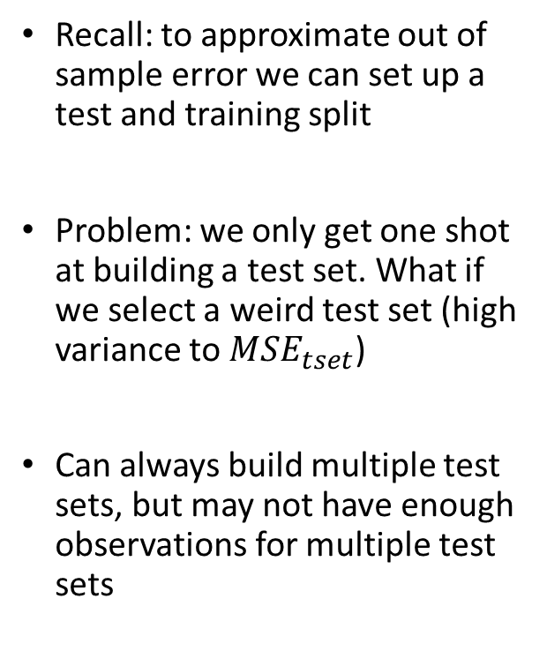
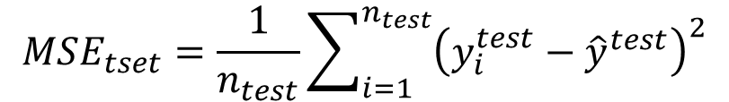

Resampling: Test-Validation Set Approach
Recall: to approximate out of sample error we can set up a test and training split
Problem: we only get one shot at building a test set. What if we select a weird test set (high variance to $MSE_{tset}$)
Can always build multiple test sets, but may not have enough observations for multiple test sets
mpg | cyl | Displ
20 | 4 | 3
15 | 6 | 5
12 | 4 | 2.4
10 | 8 | 4.6
14 | 6 | 3
25 | 4 | 2
$$\hat{f}(X^{train})$$
training
$${\hat{y}}^{test}=\hat{f}(X^{test})$$
test
$$MSE_{tset}=\frac{1}{n_{test}}\sum_{i=1}^{n_{test}}{{\left(y_{i}^{test}−{\hat{y}}^{test}\right)}^{2}}$$

Slide 26

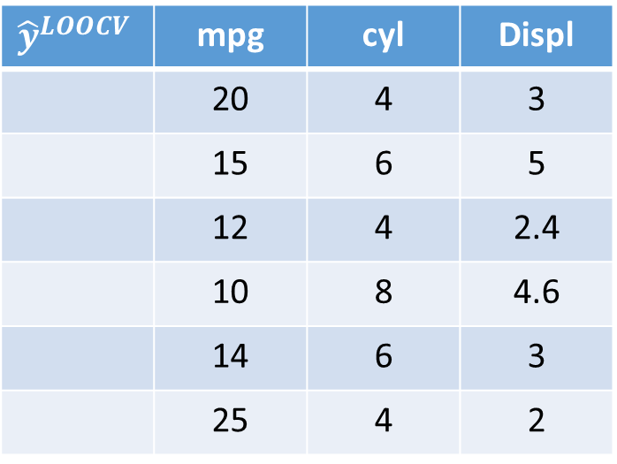


Resampling: Leave-One-Out Cross-Validation
Idea of LOOCV: Let’s approximate a bunch of test sets, each of size 1
We start with estimating a model using every observation except 1.
Use that model to predict into observation 1.
$${\hat{y}}^{LOOCV}$$ | mpg | cyl | Displ
 | 20 | 4 | 3
 | 15 | 6 | 5
 | 12 | 4 | 2.4
 | 10 | 8 | 4.6
 | 14 | 6 | 3
 | 25 | 4 | 2
$${{\hat{y}}^{LOOCV}=\hat{f}}_{X^{1}}(X^{1})$$
18
$${\hat{f}}_{X^{−1}}(X^{−1})$$
training
$X^{−1}:$ X excluding observation 1

Slide 27



Resampling: Leave-One-Out Cross-Validation
We then exclude observation 2 use observations 1,3,..,n to fit a model.
We use the estimates from that model to predict into observation 2
$${\hat{y}}^{LOOCV}$$ | mpg | cyl | Displ
 | 20 | 4 | 3
 | 15 | 6 | 5
 | 12 | 4 | 2.4
 | 10 | 8 | 4.6
 | 14 | 6 | 3
 | 25 | 4 | 2
training
18
$${{\hat{y}}^{LOOCV}=\hat{f}}_{X^{−2}}(X^{−2})$$
16
$${\hat{f}}_{X^{−2}}(X^{−2})$$
training
$X^{−2}:$ X excluding observation 2

Slide 28

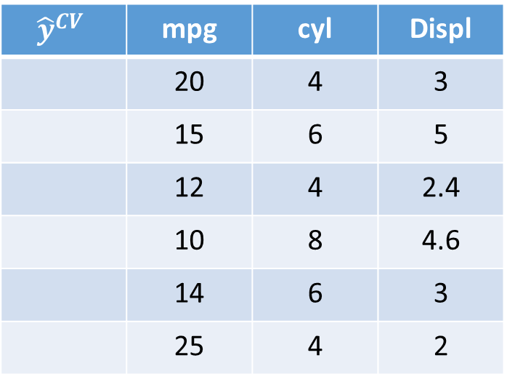


Resampling: Leave-One-Out Cross-Validation
We then exclude observation 2 use observations 1,3,..,n to fit a model.
We use the estimates from that model to predict into observation 2
And we proceed in that manner until we have predictions for every observation
$${\hat{y}}^{CV}$$ | mpg | cyl | Displ
 | 20 | 4 | 3
 | 15 | 6 | 5
 | 12 | 4 | 2.4
 | 10 | 8 | 4.6
 | 14 | 6 | 3
 | 25 | 4 | 2
18
training
16
$${{\hat{y}}^{LOOCV}=\hat{f}}_{X^{−3}}(X^{−3})$$
12
$${\hat{f}}_{X^{−3}}(X^{−3})$$
training
$X^{−3}:$ X excluding observation 3

Slide 29



Resampling: Leave-One-Out Cross-Validation
We then exclude observation 2 use observations 1,3,..,n to fit a model.
We use the estimates from that model to predict into observation 2
And we proceed in that manner until we have predictions for every observation
$${\hat{y}}^{CV}$$ | mpg | cyl | Displ
 | 20 | 4 | 3
 | 15 | 6 | 5
 | 12 | 4 | 2.4
 | 10 | 8 | 4.6
 | 14 | 6 | 3
 | 25 | 4 | 2
18
$${\hat{f}}_{X^{\{−4\}}}(X^{\{−4\}})$$
training
16
12
$${{\hat{y}}^{LOOCV}=\hat{f}}_{X^{\{−4\}}}(X^{\{4\}})$$
11
training
$X^{\{−4\}}:$ X excluding observation 4

Slide 30



Resampling: Leave-One-Out Cross-Validation
We then exclude observation 2 use observations 1,3,..,n to fit a model.
We use the estimates from that model to predict into observation 2
And we proceed in that manner until we have predictions for every observation
$${\hat{y}}^{LOOCV}$$ | mpg | cyl | Displ
 | 20 | 4 | 3
 | 15 | 6 | 5
 | 12 | 4 | 2.4
 | 10 | 8 | 4.6
 | 14 | 6 | 3
 | 25 | 4 | 2
18
$${\hat{f}}_{X^{\left\{−5\right\}}}(X^{\{−5\}})$$
training
16
12
11
$${{\hat{y}}^{LOOCV}=\hat{f}}_{X^{\left\{−5\right\}}}(X^{\{5\}})$$
15
training
$X^{\{−5\}}:$ X excluding observation 1

Slide 31



Resampling: Leave-One-Out Cross-Validation
We then exclude observation 2 use observations 1,3,..,n to fit a model.
We use the estimates from that model to predict into observation 2
And we proceed in that manner until we have predictions for every observation
$${\hat{y}}^{LOOCV}$$ | mpg | cyl | Displ
 | 20 | 4 | 3
 | 15 | 6 | 5
 | 12 | 4 | 2.4
 | 10 | 8 | 4.6
 | 14 | 6 | 3
 | 25 | 4 | 2
18
$${\hat{f}}_{X^{\left\{−6\right\}}}(X^{\{−6\}})$$
training
16
12
11
11
$${{\hat{y}}^{LOOCV}=\hat{f}}_{X^{\left\{−6\right\}}}(X^{\{6\}})$$
22
$X^{\{−6\}}:$ X excluding observation 6

Slide 32
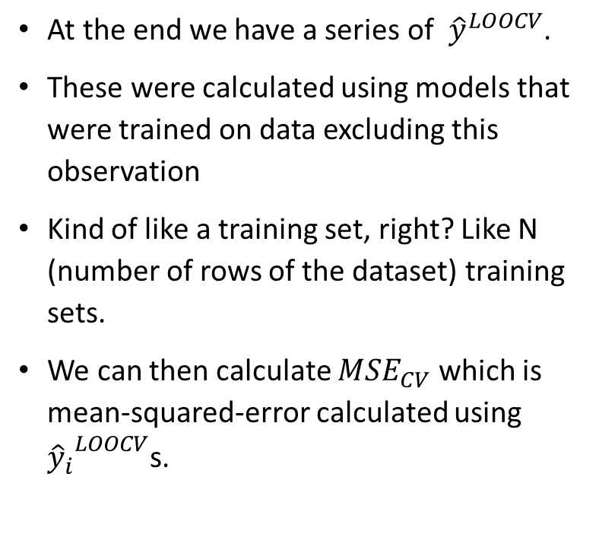
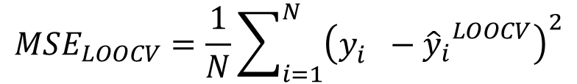
Leave-One-Out Cross-Validation
At the end we have a series of ${\hat{y}}^{LOOCV}$.
These were calculated using models that were trained on data excluding this observation
Kind of like a training set, right? Like N (number of rows of the dataset) training sets.
We can then calculate $MSE_{CV}$ which is mean-squared-error calculated using ${{\hat{y}}_{i}}^{LOOCV}$s.
$${\hat{y}}^{LOOCV}$$ | mpg | cyl | Displ
 | 20 | 4 | 3
 | 15 | 6 | 5
 | 12 | 4 | 2.4
 | 10 | 8 | 4.6
 | 14 | 6 | 3
 | 25 | 4 | 2
18
16
12
11
11
22
$$MSE_{LOOCV}=\frac{1}{N}\sum_{i=1}^{N}{{\left(y_{i}^{}−{{\hat{y}}_{i}}^{LOOCV}\right)}^{2}}$$

Slide 33
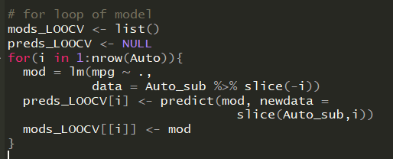
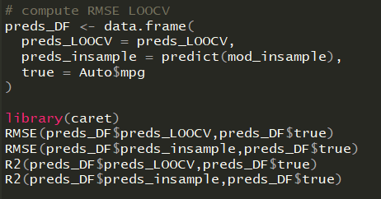
Leave-One-Out Cross-Validation in R
Many automatic ways to do it (see boot package) but we will try by hand
In general performance metrics are lower (better) in-sample versus cross-validated
 | RMSE (pred vs true) | R2 (pred vs true)
In-Sample | 3.29 | 0.82
LOOCV | 3.37 | 0.81

Slide 34
BUS 696: Class 6 Outline
AI in the News
Review
Lift Charts
Calibration Plots
Severe Class Imbalance Issues
Leave-One-Out Cross-Validation
K-Fold Cross-Validation
Bootstrapping

Slide 35
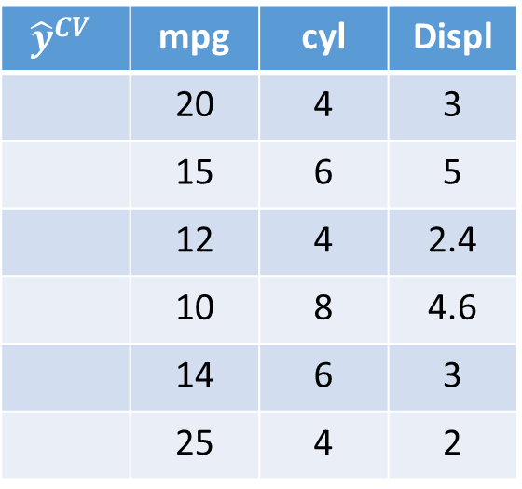
Resampling: K-Fold Cross-Validation
K-Fold Cross-Validation in contrast randomly partitions the data into k folds.
We start by estimating a model in folds 2,…,k, and using that predicted model to predict into fold 1.
This process is repeated until all folds have predictions
$${\hat{y}}^{CV}$$ | mpg | cyl | Displ
 | 20 | 4 | 3
 | 15 | 6 | 5
 | 12 | 4 | 2.4
 | 10 | 8 | 4.6
 | 14 | 6 | 3
 | 25 | 4 | 2

Slide 36

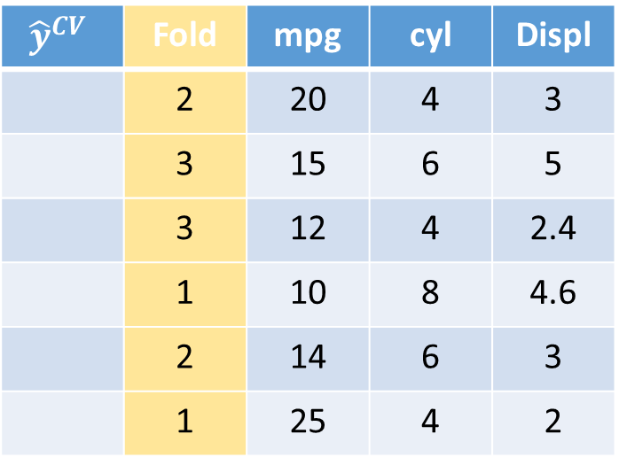

Resampling: K-Fold Cross-Validation
E.g. we set k = 3 and do 3-Fold Cross-Validation
Fit a model using observations 1-3 and 5 (folds 2-3)
Then use this model to predict into fold 1.
$${\hat{y}}^{CV}$$ | Fold | mpg | cyl | Displ
 | 2 | 20 | 4 | 3
 | 3 | 15 | 6 | 5
 | 3 | 12 | 4 | 2.4
 | 1 | 10 | 8 | 4.6
 | 2 | 14 | 6 | 3
 | 1 | 25 | 4 | 2
$${\hat{f}}_{X^{\left\{−1\right\}}}(X^{\{−1\}})$$
11
23
$X^{\{−1\}}:$ X excluding fold 1

Slide 37


Resampling: K-Fold Cross-Validation
E.g. we set k = 3 and do 3-Fold Cross-Validation
Next we fit a a model using folds 1 & 3
Then use this model to predict into fold 2.
$${\hat{y}}^{CV}$$ | Fold | mpg | cyl | Displ
 | 2 | 20 | 4 | 3
 | 3 | 15 | 6 | 5
 | 3 | 12 | 4 | 2.4
 | 1 | 10 | 8 | 4.6
 | 2 | 14 | 6 | 3
 | 1 | 25 | 4 | 2
22
$${\hat{f}}_{X^{\left\{−2\right\}}}(X^{\{−2\}})$$
11
14
23
$X^{\{−3\}}:$ X excluding fold 1

Slide 38

Resampling: K-Fold Cross-Validation
E.g. we set k = 3 and do 3-Fold Cross-Validation
Finally we predict using data in folds 1-2
Then use this model to predict into fold 3.
$${\hat{y}}^{CV}$$ | Fold | mpg | cyl | Displ
 | 2 | 20 | 4 | 3
 | 3 | 15 | 6 | 5
 | 3 | 12 | 4 | 2.4
 | 1 | 10 | 8 | 4.6
 | 2 | 14 | 6 | 3
 | 1 | 25 | 4 | 2
22
$${\hat{f}}_{X^{\left\{−3\right\}}}(X^{\{−3\}})$$
17
13
11
14
23
$X^{\{−3\}}:$ X excluding fold 1

Slide 39
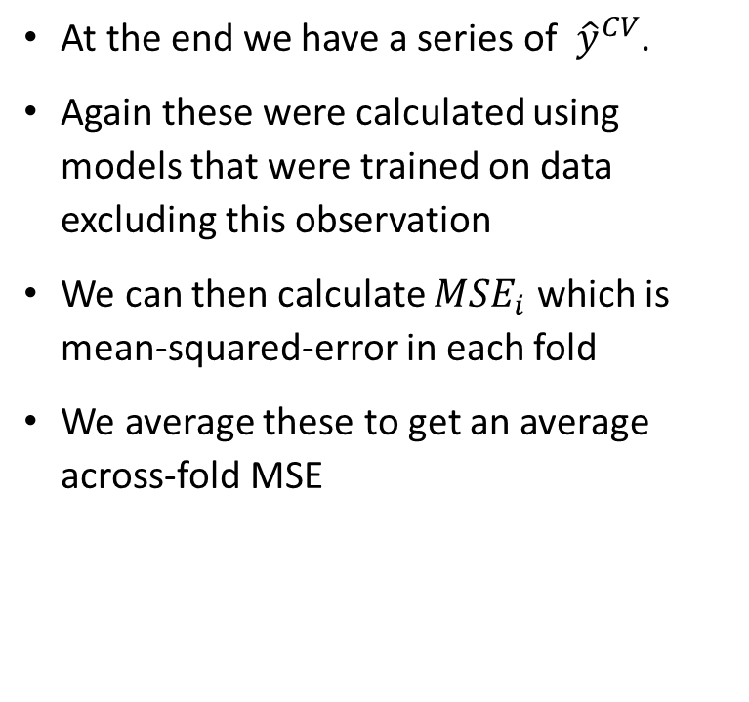
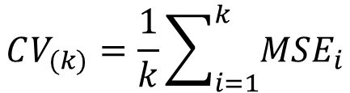
K-Fold Cross-Validation Error
At the end we have a series of ${\hat{y}}^{CV}$.
Again these were calculated using models that were trained on data excluding this observation
We can then calculate $MSE_{i}$ which is mean-squared-error in each fold
We average these to get an average across-fold MSE
$${\hat{y}}^{CV}$$ | mpg | cyl | Displ
 | 20 | 4 | 3
 | 15 | 6 | 5
 | 12 | 4 | 2.4
 | 10 | 8 | 4.6
 | 14 | 6 | 3
 | 25 | 4 | 2
18
16
12
11
11
22
$$CV_{(k)}=\frac{1}{k}\sum_{i=1}^{k}{MSE_{i}}$$

Slide 40
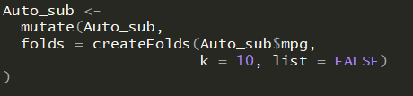
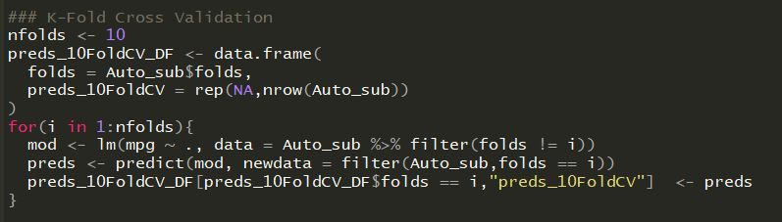
K-Fold Cross-Validation in R
Many ways to create folds, but the createFolds() package in `caret` is helpful here.

Slide 41
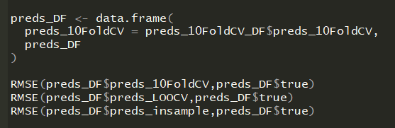
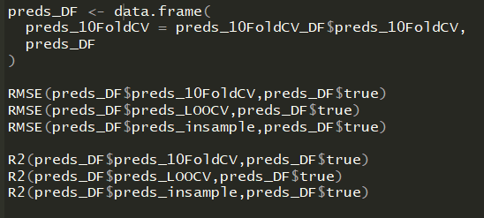
K-Fold Cross-Validation in R
 | RMSE (pred vs true) | R2 (pred vs true)
In-Sample | 3.29 | 0.82
LOOCV | 3.37 | 0.812
K-Fold CV | 3.37 | 0.812

Slide 42
BUS 696: Class 6 Outline
AI in the News
Review
Lift Charts
Calibration Plots
Severe Class Imbalance Issues
Leave-One-Out Cross-Validation
K-Fold Cross-Validation
Bootstrapping

Slide 43
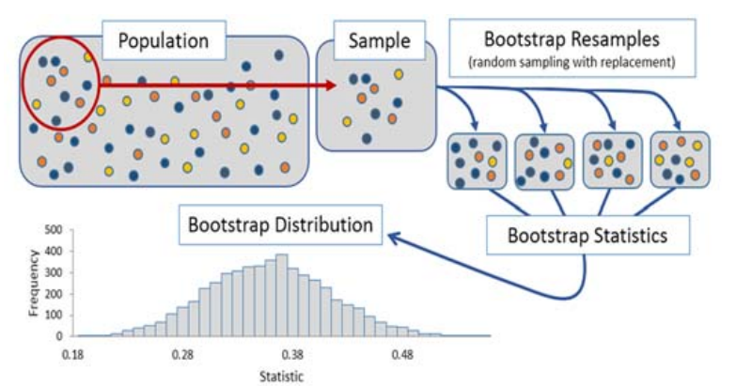
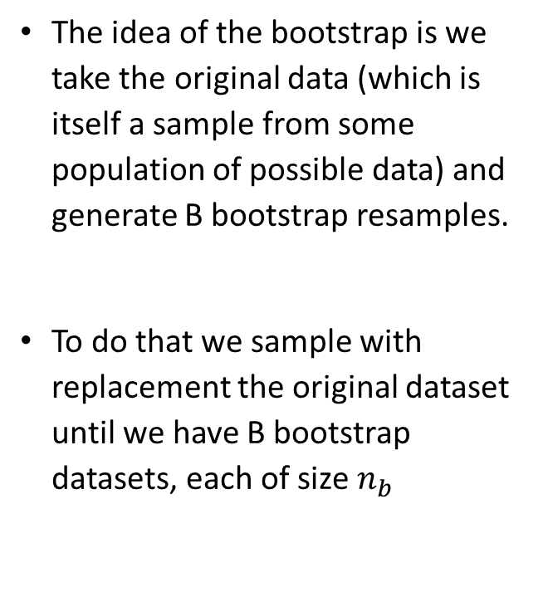
Bootstrap
The idea of the bootstrap is we take the original data (which is itself a sample from some population of possible data) and generate B bootstrap resamples.
To do that we sample with replacement the original dataset until we have B bootstrap datasets, each of size $n_{b}$

Slide 44
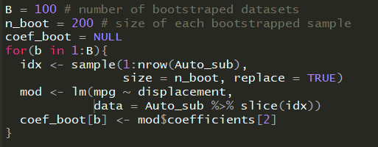
Bootstrapping in R
Again, many ways to do it. First we do it by hand.

Slide 45
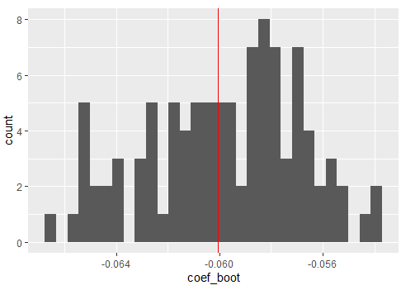
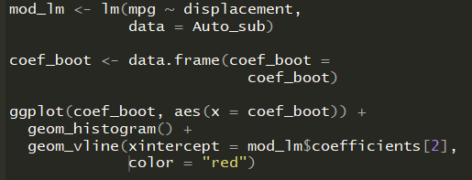
Bootstrapping in R
Linear model coefficient on original sample
Each point shows a coefficient from a different bootstrapped sample

